Slide 1


WDMM 3314 Web and Multimedia Engineering SDEV 2301 Principles of Software Engineering Project
Dr. Nour Almadhoun Alserr
Lecture 7 (23 Sep. 2023)
Week 3
Notes:
Overcome Challenges

Slide 2
Project requirements
The students must learn and use the following software tools carefully:
Microsoft (MS) MS Project
Visual Paradigm
Visual Studio Code
NetBeans
The students must have good experience with at least one of the following programming languages:
Java
JavaScript
PHP
Python
Notes:
Visual Studio Code support: C++ - C# - CSS - Dart - Dockerfile - F# - Go - HTML - Java - JavaScript - JSON - Julia - Less - Markdown - PHP - PowerShell - Python - R - Ruby - Rust - SCSS - T-SQL - TypeScript.

Slide 3

Microsoft (MS) Project
Microsoft Project is a project management software product, developed and sold by Microsoft. It is designed to assist a project manager in developing a schedule, assigning resources to tasks, tracking progress, managing the budget, and analyzing workloads.
https://www.microsoft.com/en-us/microsoft-365/project/project-management

Slide 4

Visual Paradigm
Visual Paradigm is a UML CASE Tool supporting UML 2, Systems modeling language (SysML) and Business Process Modeling. In addition to the modeling support, it provides report generation and code engineering capabilities including code generation.
https://en.wikipedia.org/wiki/Visual_Paradigm

Slide 5
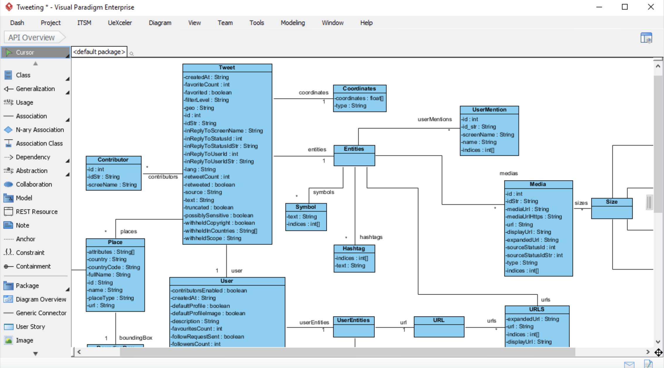
Visual Paradigm
https://en.wikipedia.org/wiki/Visual_Paradigm

Slide 6
Project Guidelines
Group of 2 to 3 students is assigned a project.
Deliverables: documentation for project plan, system specification, design, implementation, testing and operational software application, in addition to a recorded video (a presentation explains the developed web application).
Written in English and adhered to the project template.
Divided into sections; and submitted before the due date.
Selected proposed projects are provided, although you can propose your own project (must be approved).
Upload the web application and the video on your Google drive and submit a link for it on Moodle before due date.

Slide 7
Proposed Projects
Point of Sale Management System
Laboratory Management System
Clinic Management System
Training Courses Center
Human Resources System for Small Business
Bookshop Management System
Faculty Management System in a University
Mobile/Computer Selling Center
Charitable Organization Management System
Events Scheduling Systems
Digital Products Management Systems
Accounting System for Small Business
From Dr. Abdelkareem Alashqar slides.

Slide 8
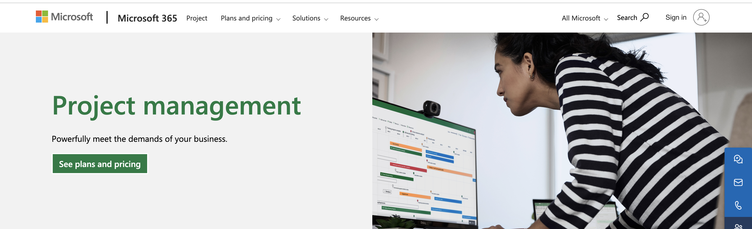
Microsoft (MS) Project
Microsoft Project is a project management software product, developed and sold by Microsoft. It is designed to assist a project manager in developing a schedule, assigning resources to tasks, tracking progress, managing the budget, and analyzing workloads.
https://www.microsoft.com/en-us/microsoft-365/project/project-management

Slide 9
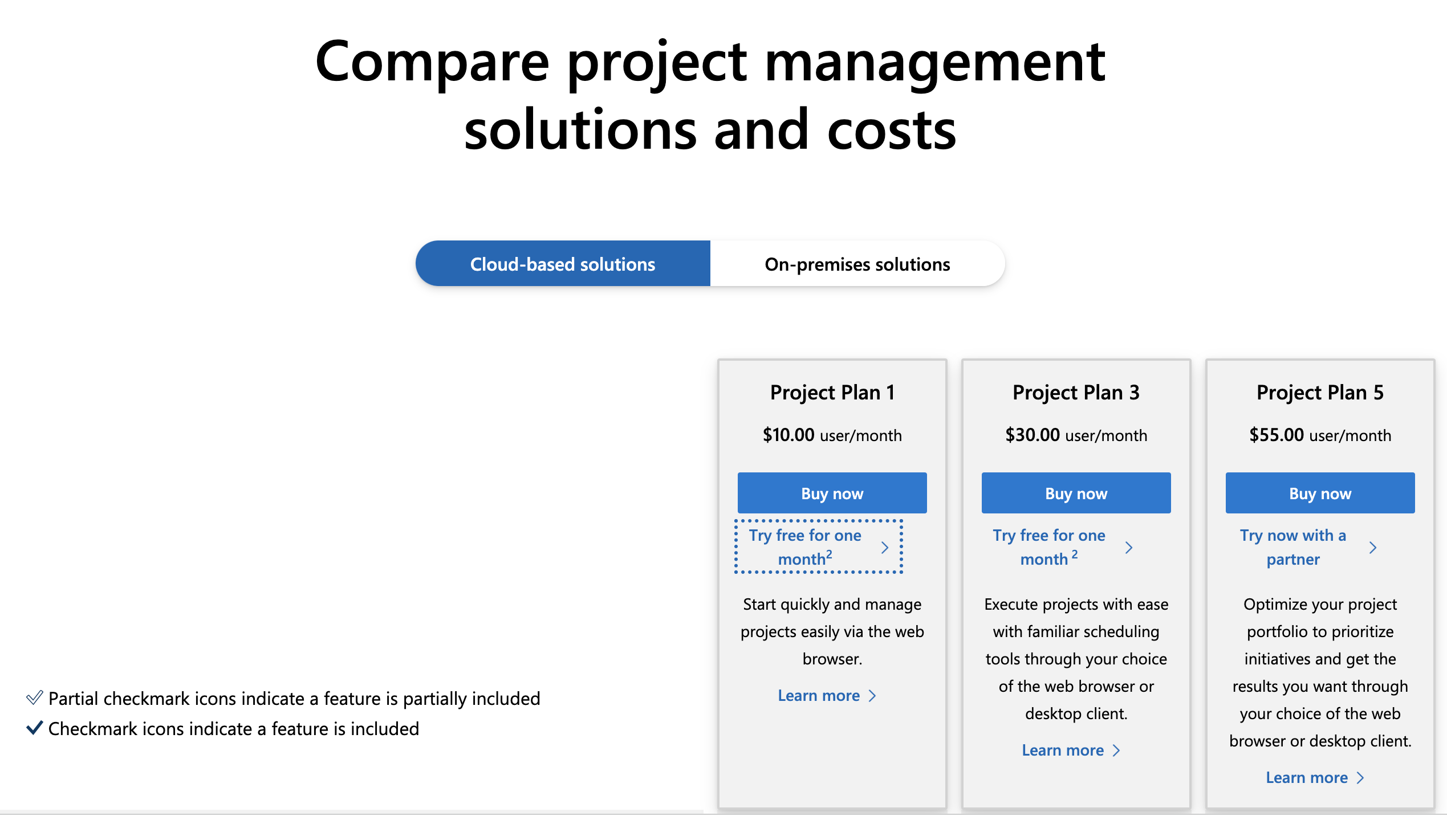
MS Project Installation (1/7)
If you prefer a browser-based version of the Project, you can opt for Plan 1. However, if you wish to download the application, you will need to consider either Plan 3 or 5.
https://www.wizcase.com/download/microsoft-project/

Slide 10
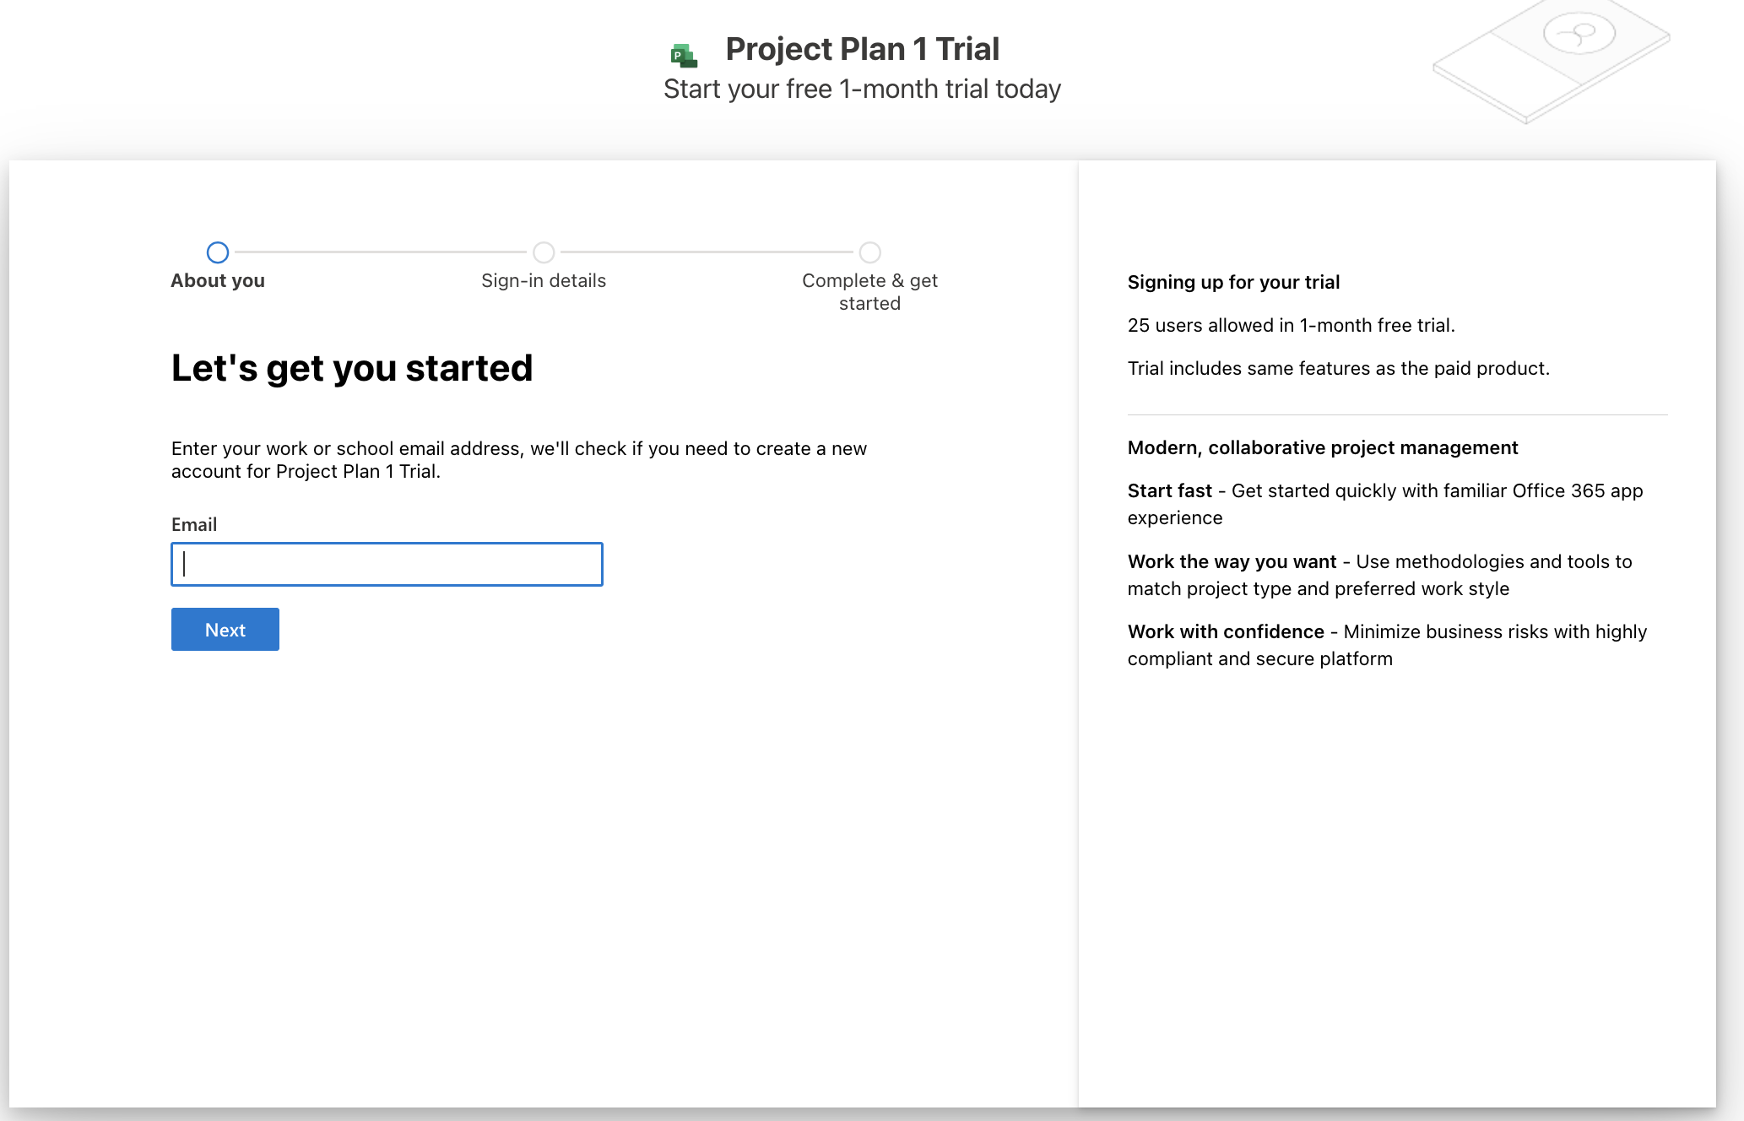
MS Project Installation (2/7)
You will have to create your new account. Enter a valid email address and click Set Up account.

Slide 11
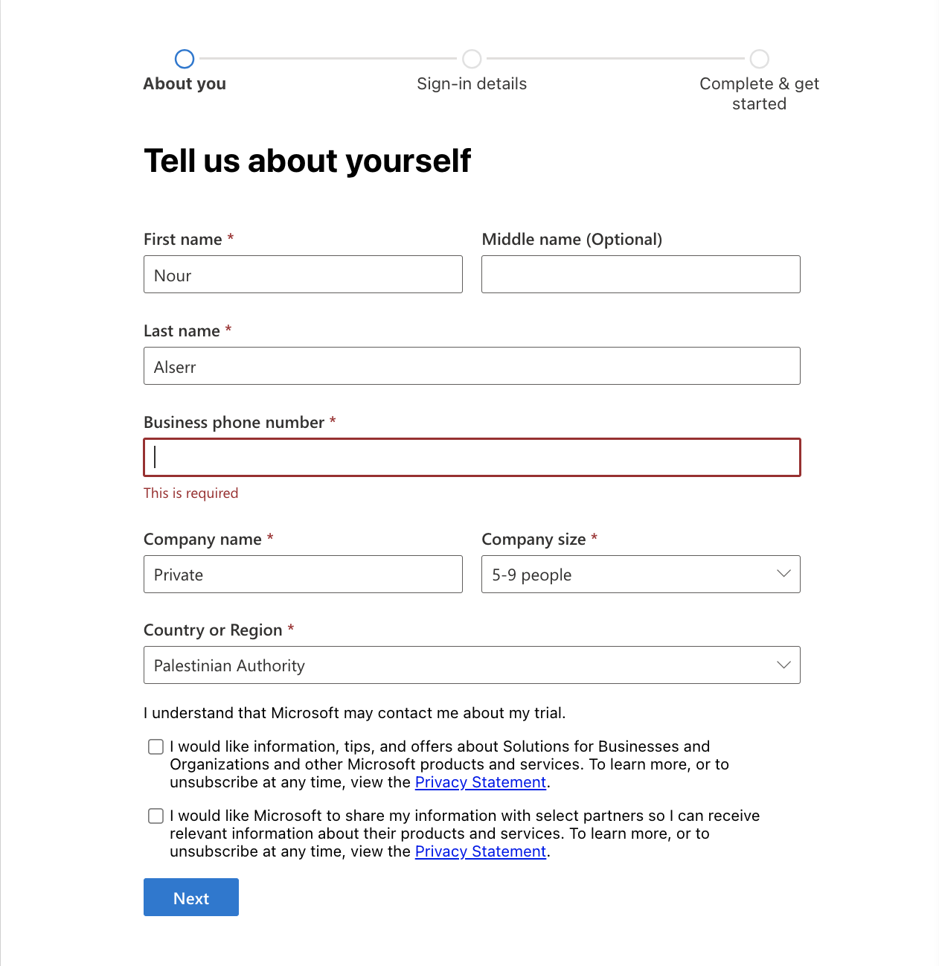
MS Project Installation (3/7)
Fill in your first and last name, business phone number, name of your company, number of employees, and the country or region where your business is located, and then click Next.
Notes:
By doing so, you have the option to receive exclusive offers from Microsoft and grant them permission to share your data with specific partners, aiming to enhance performance. However, if you prefer not to receive these offers, simply leave the checkboxes unchecked and proceed

Slide 12
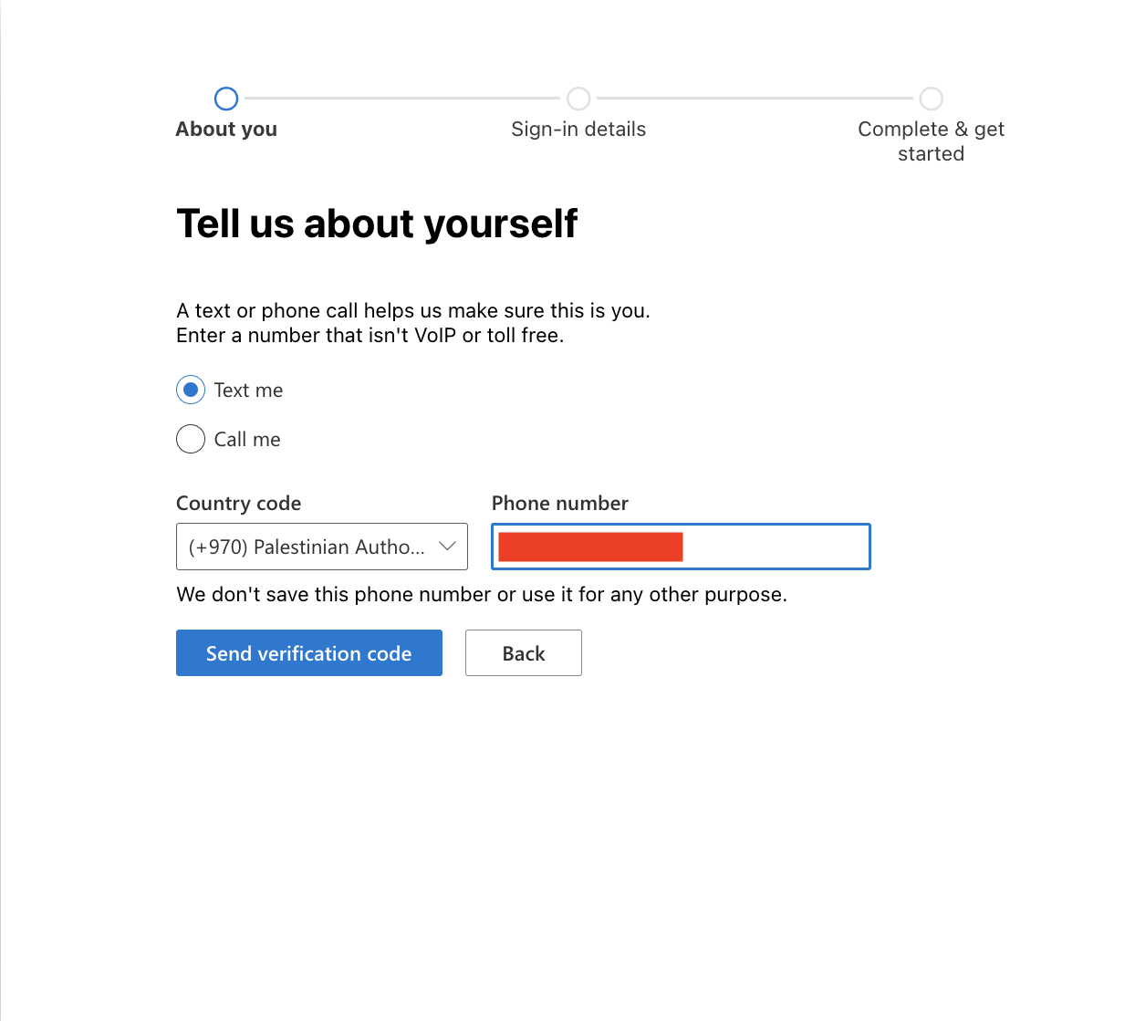
MS Project Installation (4/7)
Microsoft will verify your account by sending a text or calling your phone number. After you input the 8-digit code, press the Verify button.

Slide 13
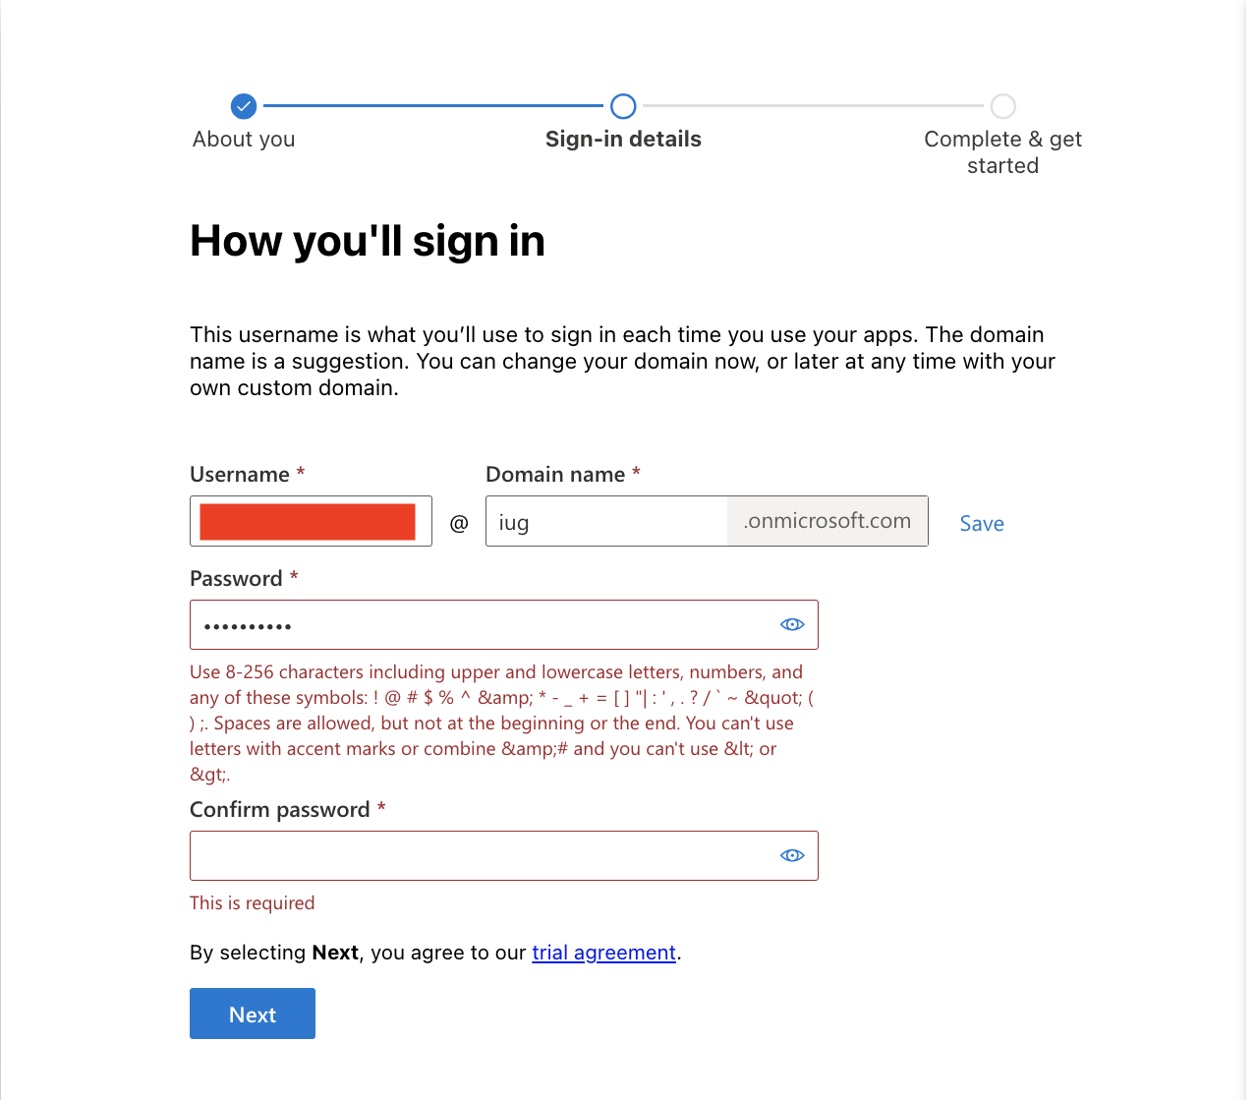
MS Project Installation (5/7)
In order to set up the account, it is necessary to have a domain name. Microsoft provides a domain name that concludes with “.onmicrosoft.com”.
Notes:
A domain name is a unique, easy-to-remember address used to access websites, such as 'google.com', and 'facebook.com'. Users can connect to websites using domain names thanks to the DNS (domain name system).
A Domain Name System (DNS) turns domain names into IP (internet protocol) addresses, which allow browsers to get to websites and other internet resources. Every device on the internet has an IP address, which other devices can use to locate the device. Instead of memorizing a long list of IP addresses, people can simply enter the name of the website, and the DNS gets the IP address for them.

Slide 14
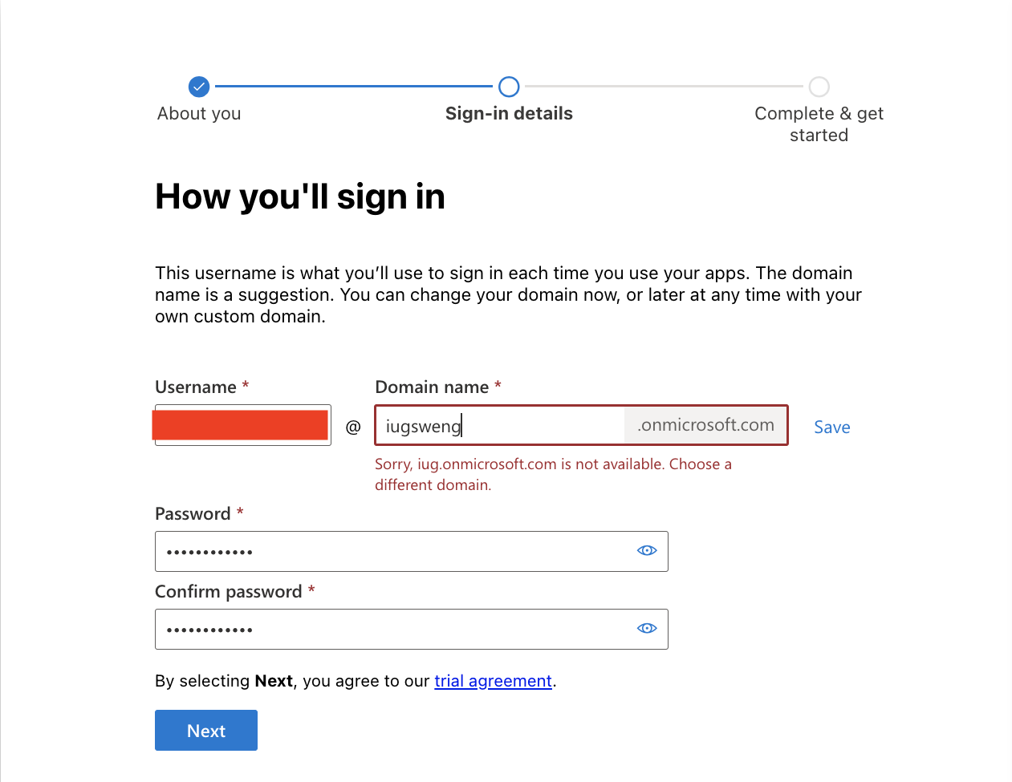
MS Project Installation (5/7)
Simply input your business name to generate the domain name (unique) and set up your own unique username and password.

Slide 15
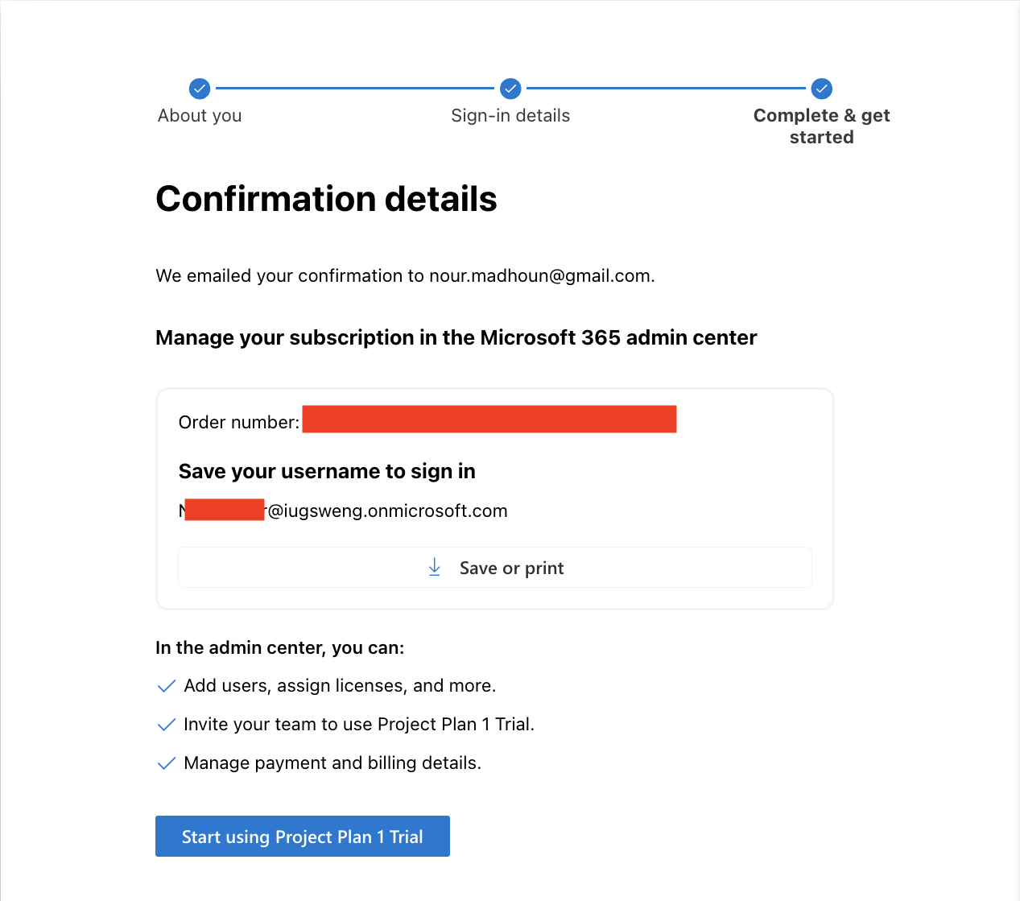
MS Project Installation (6/7)

Slide 16
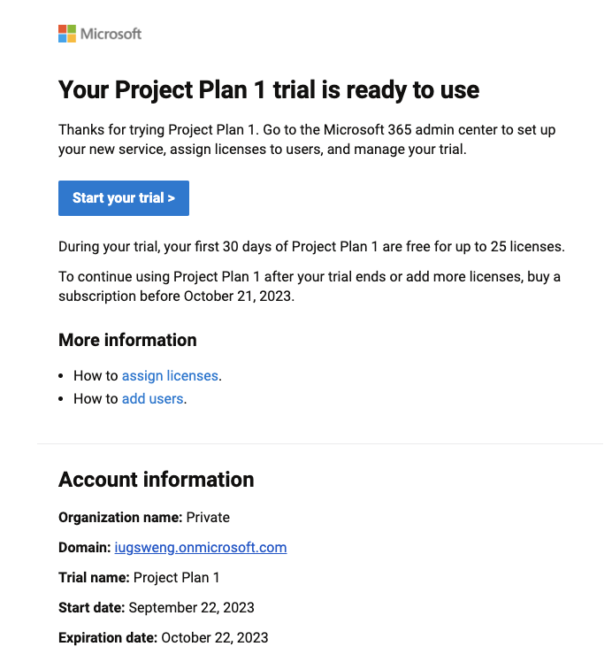
MS Project Installation (7/7)
Email Confirmation.

Slide 17
Case Studies (Book)
A personal insulin pump.
A mental health care patient management system.
A wilderness weather station.
iLearn: a digital learning environment.
Notes:
An embedded system in an insulin pump used by diabetics to maintain blood glucose control.
Mentcare. A system used to maintain records of people receiving care for mental health problems.
A data collection system that collects data about weather conditions in remote areas.
A system to support learning in schools

Slide 18

Do you have
any QUESTIONS?!
Notes:
Do you have any Questions?

